Slide 1

Comments Sentiment Analysis
YouTube
Unveiling the Voice of the Viewer

Slide 2





OUR TEAM - 5
Purvi Bharani
Neena CHAUDHARI
Gaurav Mishra
aNJALI DEVRANI
Prashasti Patil

Slide 3
TABLE OF CONTENTS
01
03
02
04
06
05
06
INTRODUCTION
ABOUT DATA
GOALS & STRATEGY
DATA PREPROCESSING
SENTIMENT ANALYSIS
VISUALIZATION
CONCLUSION

Slide 4


INTRODUCTION
Explored YouTube comment sentiment to reveal viewer preferences, using analytics and machine learning to help creators improve their videos and audience engagement.

Slide 5

GOALS & STRATEGY
Address the challenge of processing and interpreting the vast quantity of comments on YouTube videos.
Tackle the difficulties posed by the informal and varied language used in comments, including slang, emojis, and cultural references.
Provide a solution for the need of content creators to incorporate real-time feedback into their content development process.

Slide 6



ABOUT DATA
8k
100k +
sTATIC + REAL-TIME
VIDEOS
COMMENTS

Slide 7
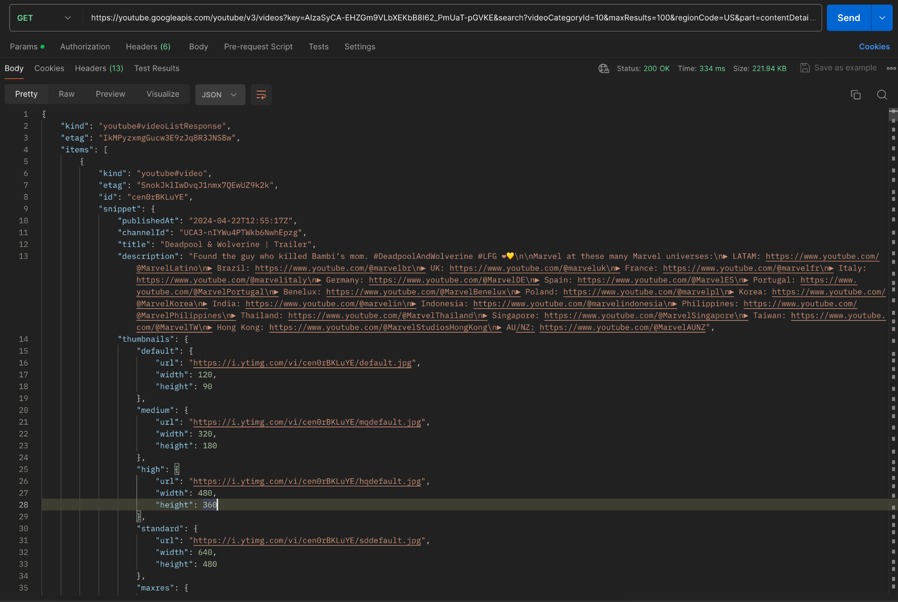
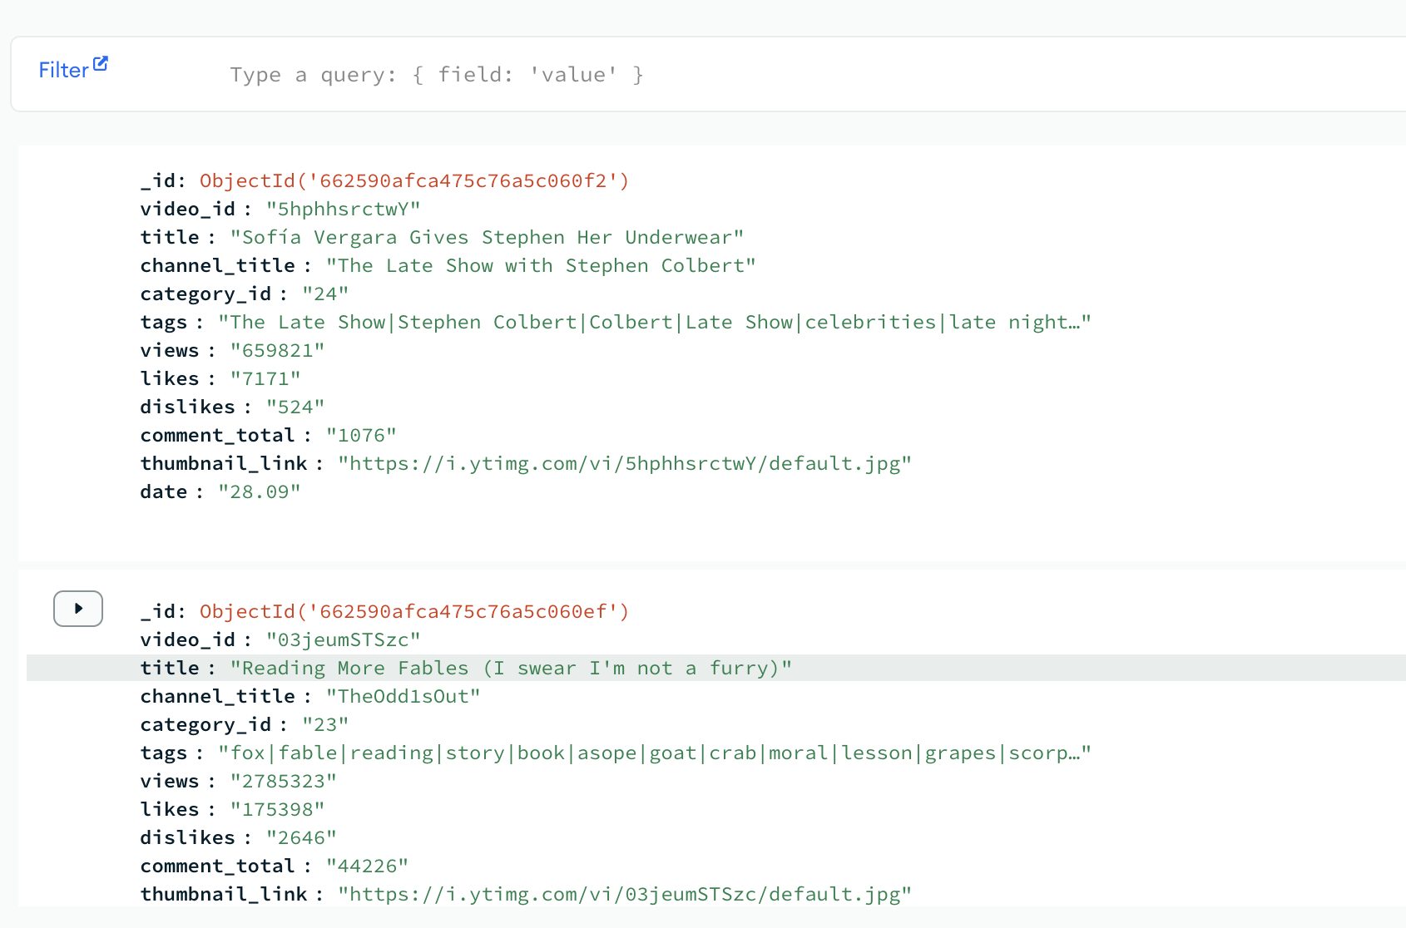
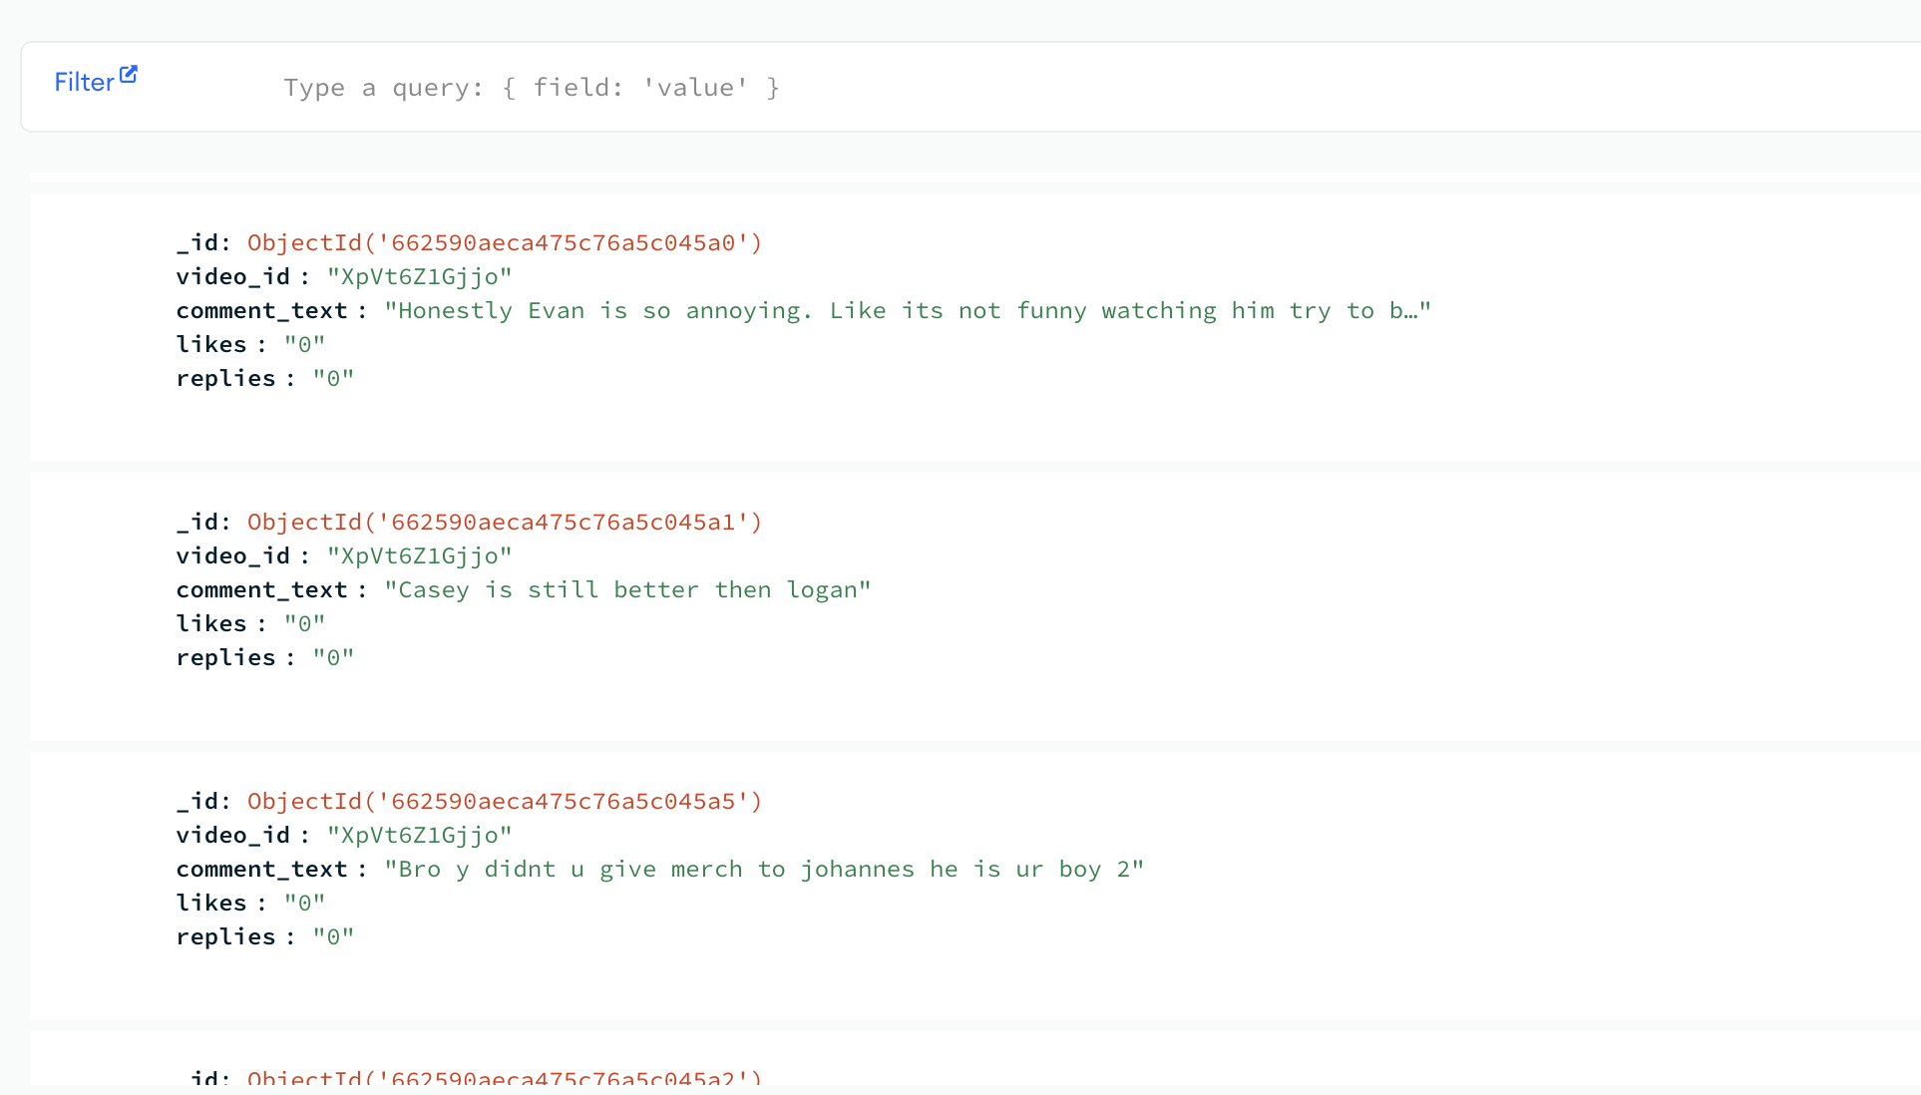
Data Sample

Slide 8

DATA PREPROCESSING
VIDEOS
COMMENTS
SPECIAL CHARACTERS
TOKENIZATION
Remove null
LEMMATIZATION

Slide 9

SENTIMENT ANALYSIS
A
D
B
C
VADER
SVC
SVC provides a robust method for high-precision sentiment categorization for YouTube comments.
Tailored for social media text, VADER excels in detecting sentiment intensity in YouTube comments
Random forest
NAIVE BAYES
An ensemble approach that combines multiple decision trees, optimizing sentiment analysis for YouTube's diverse comments
A probabilistic technique, Naive Bayes offers swift and reliable sentiment classification for YouTube comments
Notes:
Importance of analyzing sentiment in YouTube comments - Analyzing sentiment in YouTube comments helps content creators understand viewer reactions, optimize content, and manage brand reputation. It enables targeted marketing, enhances user experience, and measures performance to drive growth and success on the platform.
VADER was used for quick sentiment scoring and initial analysis of YouTube comments due to its lexicon-based approach tailored for social media text, providing a baseline for sentiment classification before implementing machine learning models for more complex sentiment prediction.
Calculate sentiment scores for each comment (e.g., positive, negative, neutral).
We used 3 machine learning models for sentiment prediction on the preprocessed YouTube comments.
We used TF-IDF Vectorization to convert the preprocessed text data into numerical features that can be fed into machine learning models. We converted the categorical sentiment labels (Positive, Neutral, Negative) into numerical labels using Label Encoding for training the machine learning models. We split the dataset into training and testing sets, trained each machine learning model on the training set using the TF-IDF features and sentiment labels, and evaluated the models' performance on the testing set using accuracy scores and classification reports.
By implementing multiple machine learning models and VADER, we compared their performance in sentiment analysis to identify the most effective approach for classifying sentiment in YouTube comments. Visualize the sentiment analysis results using charts or graphs to provide a clear overview of the sentiment distribution.

Slide 10
VADER
VADER (Valence Aware Dictionary and Sentiment Reasoner) is utilized through the “nltk.sentiment.vader” library to conduct sentiment analysis using “SentimentIntensityAnalyzer”.
The sentiment scores for each comment in the 'comment_text' column are calculated using VADER's polarity_scores method. These scores include values for positivity, neutrality, and negativity, along with an overall “compound score”. (aggregated score)
Based on the compound sentiment score, each comment is categorized as 'Positive', 'Neutral', or 'Negative'. (-1 to 1)
What is VADER?
Use & Input
Output
Notes:
VADER assigns each word in a text a polarity score (positive, negative, or neutral) and a intensity score based on a pre-built sentiment lexicon.
We applied VADER to calculate sentiment scores (compound scores) for each comment in the US_comments DataFrame.
We classified the sentiment of each comment as Positive, Neutral, or Negative based on the compound sentiment score.
Calculate % of positive comments. If 0% then negative or neutral.
Map positive comments with channel names
Apply sentiment analysis on user input.

Slide 11
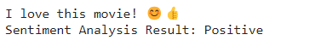
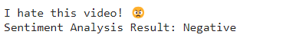
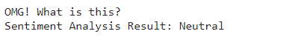
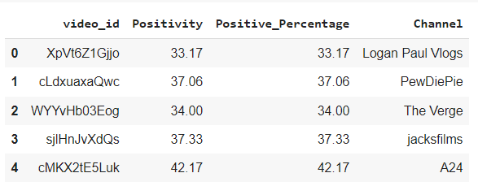
VADER
Notes:
VADER assigns each word in a text a polarity score (positive, negative, or neutral) and a intensity score based on a pre-built sentiment lexicon.
We applied VADER to calculate sentiment scores (compound scores) for each comment in the US_comments DataFrame.
We classified the sentiment of each comment as Positive, Neutral, or Negative based on the compound sentiment score.
Calculate % of positive comments. If 0% then negative or neutral.
Map positive comments with channel names
Apply sentiment analysis on user input.

Slide 12
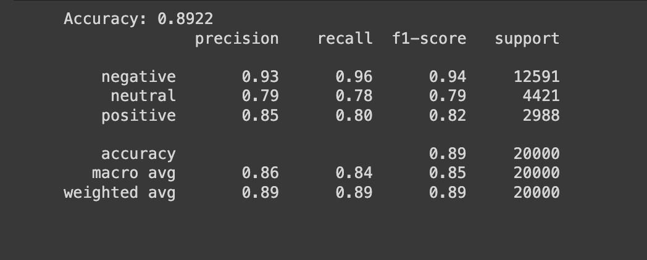
RANDOM FOREST
Random Forest is used as a machine learning classifier to predict the sentiment (Positive, Neutral, Negative) of YouTube comments based on their TF-IDF (Term Frequency-Inverse Document Frequency) features.
The input consists of TF-IDF vectorized features derived from the comment text, while the target variable is the sentiment labels for those comments.
What is Random Forest?
Use & Input
Output
Notes:
Random Forest is a classifier which consists of group of decision trees to predict sentiments. Each tree makes prediction based on input text-features from Youtube comments using TF-IDF vector. TF-IDF vector evaluates the word importance with the comments. Random forest predicts model accuracy for the comments based on sentiment labels (+ve,-ve,neutral). A new comment is converted into a TF-IDF vector which is passed down each tree in the forest. At each node of the tree, the comment is compared to the split condition based on a particular feature and a threshold value.
Each leaf node in the forest "votes" for a sentiment class (positive, neutral, or negative). The final sentiment prediction for the comment is determined by a majority vote from all the trees in the forest. The class with the most votes wins.
Let’s walkthrough the performance metrics achieved by training the random forest model: The model achieved an accuracy of 89%, which shows the percentage of comments where the model’s predicted sentiment label matched the actual sentiment label. A precision of 0.93 for negative sentiment indicates that out of all the comments the model classified as negative, 93% were truly negative.
Recall reflects the sentiment labels identified by the model.
F1 score shows a balance between precision and recall.
Random Forest leverages the power of multiple decision trees to analyze the features extracted from YouTube comments and predict their sentiment effectively.

Slide 13
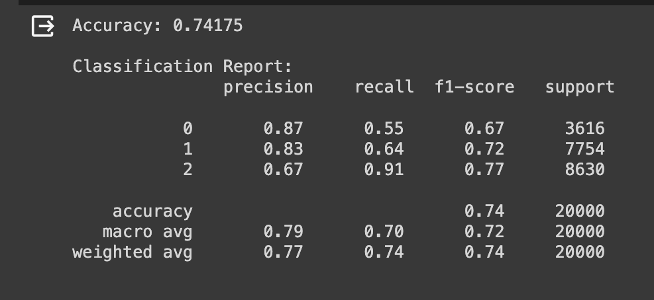
Naive bayes
Naive Bayes is a probabilistic machine learning classifier commonly used for sentiment analysis tasks. It's based on Bayes' theorem and assumes that features are independent of each other, hence the term "naive."
In sentiment analysis, Naive Bayes takes as input the TF-IDF (Term Frequency-Inverse Document Frequency) vectorized features extracted from the comment text.
What is Naive Bayes?
Use & Input
Output
Notes:
Here is the other algorithm Naive Bayes which is a probabilistic ML classifier. NB algorithm uses Bayes theorem to calculate probability of a comment belonging to a particular sentiment class. It calculates the probability of each word in the comment appearing in a specific sentiment class and multiplies those probabilities together. The sentiment class with the highest probability is assigned to the comment.
The table at the bottom of the slide shows the model’s performance on a dataset: We've achieved accuracy of 74%.

Slide 14
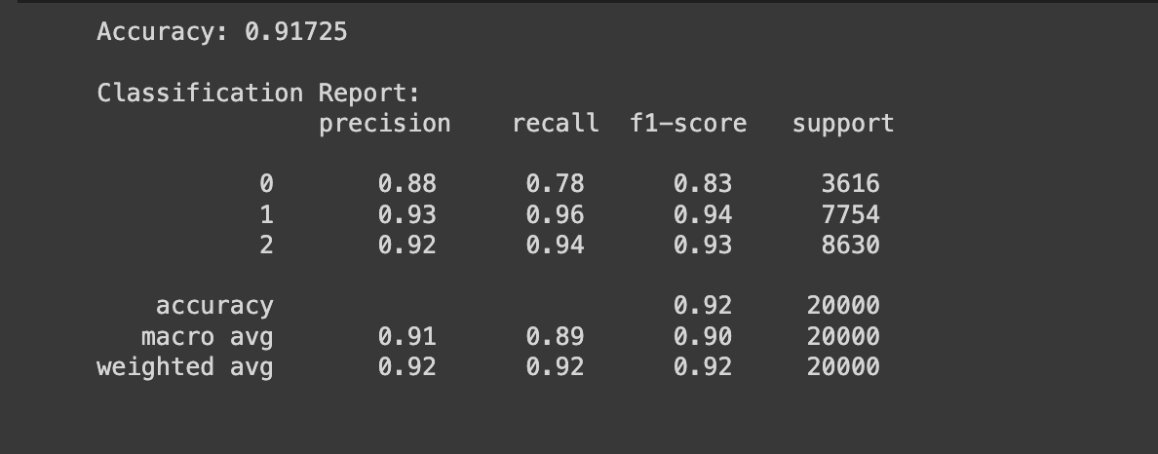
SUPPORT VECTOR MACHINE (SVC )
Support Vector Machine (SVC) is a robust and versatile machine learning algorithm that is used for classification tasks. It excels in both linear and non-linear challenges. The input for an SVC model consists of a set of data points, where each point has its own set of attributes or features, along with a label.
What is SVC?
Use & Input
Output
Notes:
How SVM Works:
Feature Extraction:
Text data (YouTube comments) is preprocessed and transformed into numerical feature vectors using techniques like TF-IDF Vectorization, Word Embeddings, or Bag-of-Words.
Training:
The preprocessed feature vectors and corresponding sentiment labels (Positive, Neutral, Negative) are used to train an SVM classifier.
During training, SVM tries to find the optimal hyperplane that separates the feature vectors into different classes while maximizing the margin between the classes.
Prediction:
Once the SVM classifier is trained, it can be used to predict the sentiment label for new or unseen YouTube comments based on their feature vectors.
The predicted sentiment labels can be evaluated and compared with the actual labels to assess the performance of the SVM model.

Slide 15
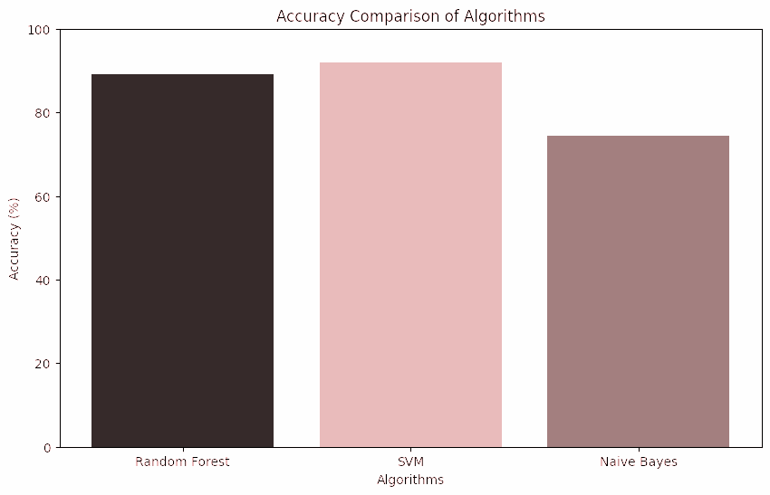
Outcomes for ML Models

Slide 16
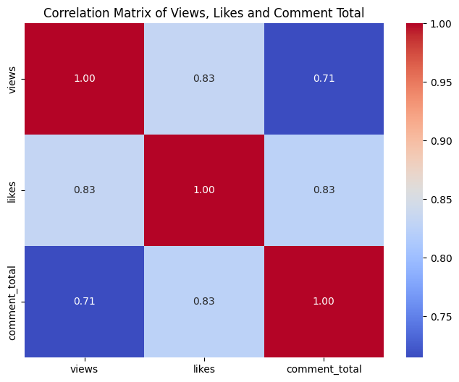
DATA VISUALIZATION
correlation matrix

Slide 17
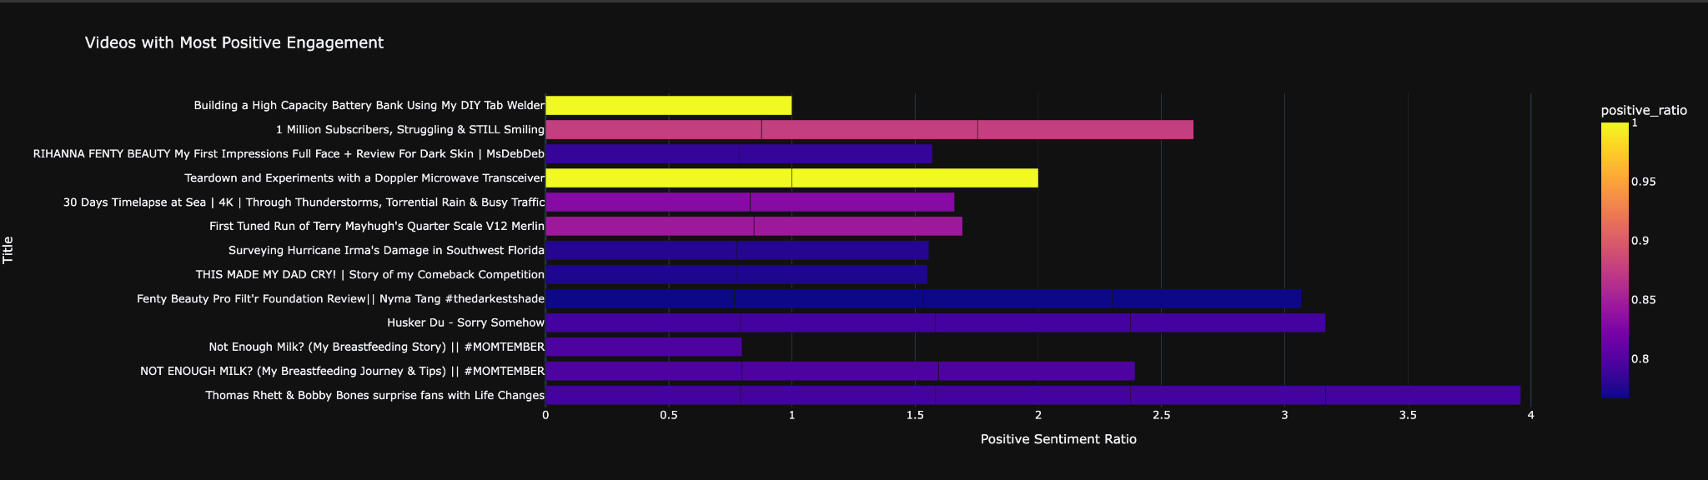
DATA VISUALIZATION
Engagement with positive comment

Slide 18
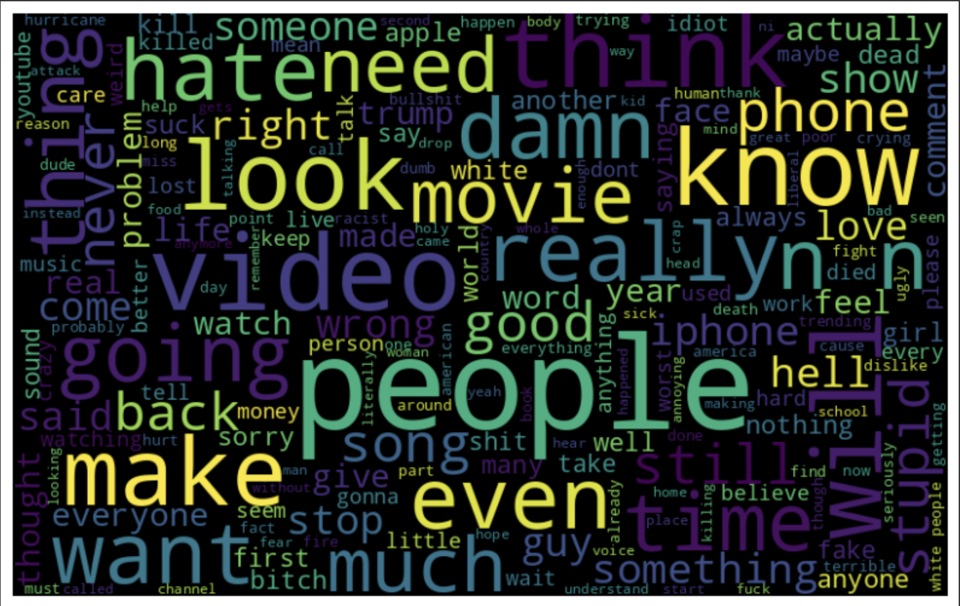
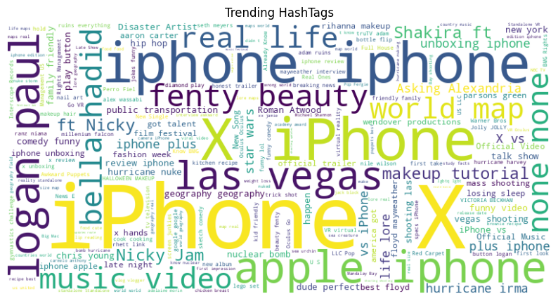
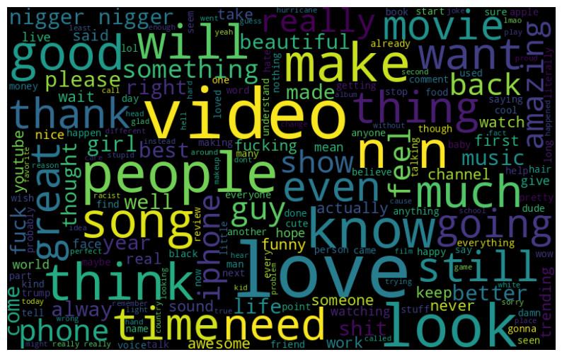
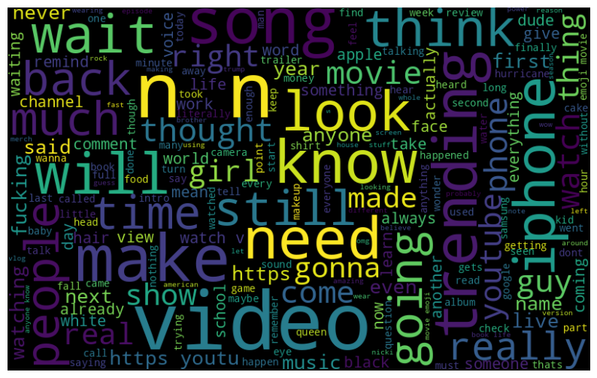
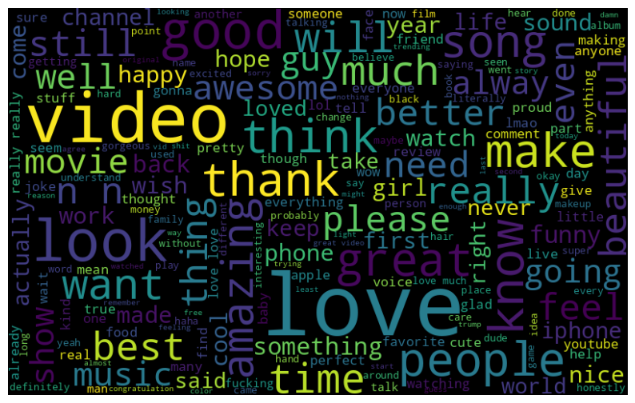
DATA VISUALIZATION
negative text in comment
tags in videos
texts in comments
neutral text in comment
positive text in comment

Slide 19
CONCLUSION
We have effectively implemented a system that deciphers the emotional tone behind YouTube comments.
Leveraged advanced data processing and machine learning models to navigate the complexity of natural language in comments.
The analysis tools developed have proven to be valuable in offering actionable feedback, enabling creators to fine-tune their content to better.
The project has set a strong foundation for scalability and future development, including the potential for real-time sentiment analysis .

Slide 20

Thank you
Please keep this slide for attribution

Slide 21

QUESTION & ANSWERS

